Slide 1


St. Clement’s Consultation
James Kibble

Slide 2

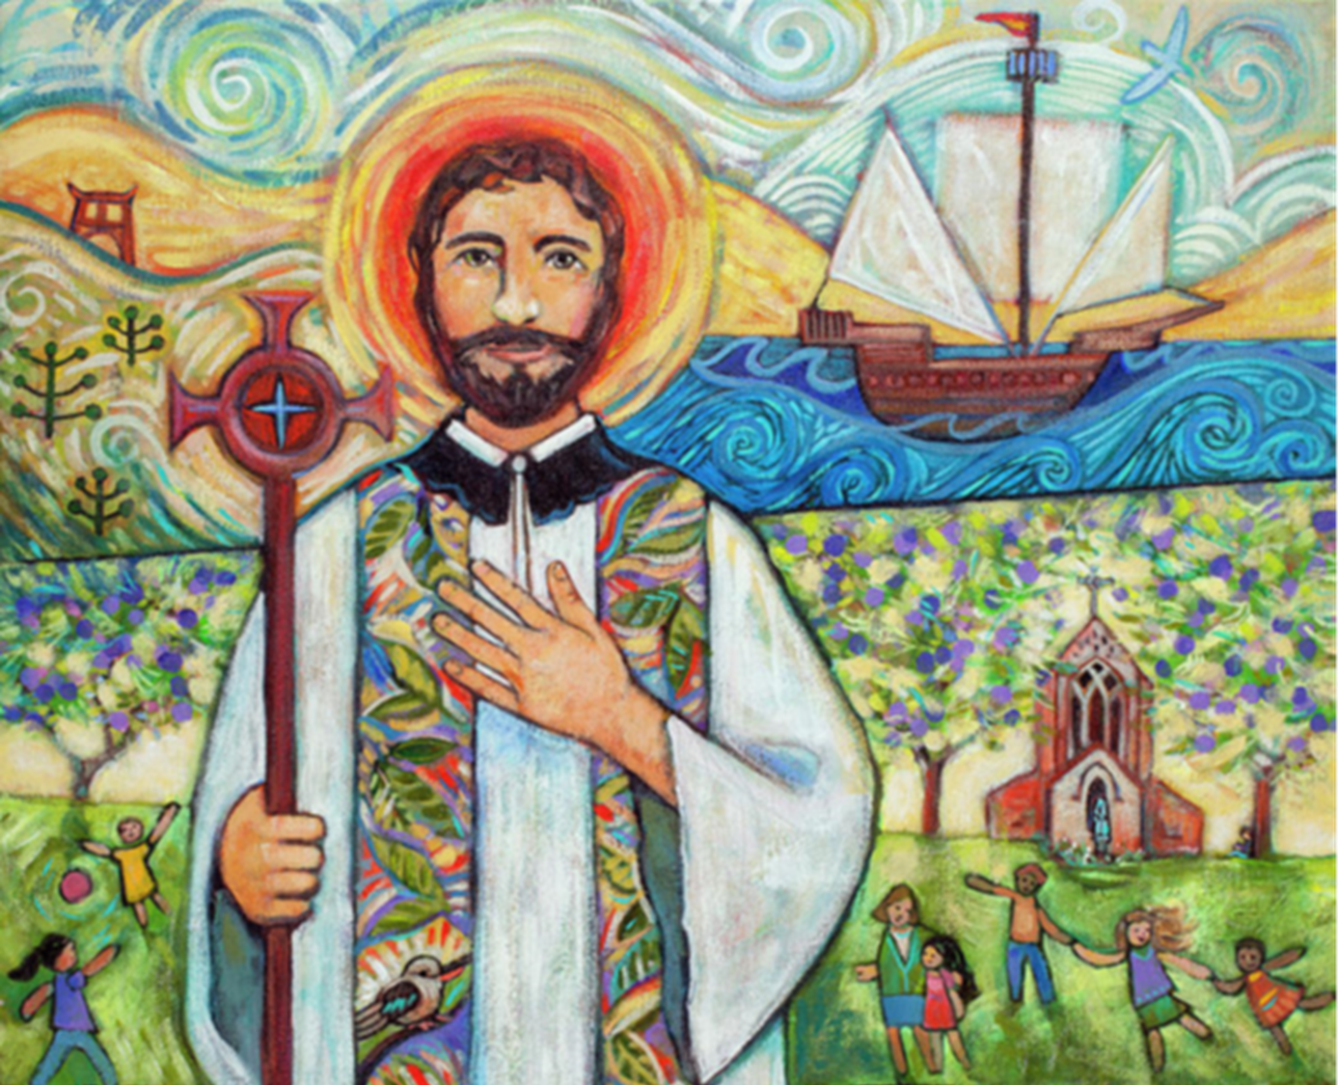
Who are we?

Slide 3
Xavier Journey
2016
2 Teaching Schools & 7 feeder Primary Schools
2024
19 Schools across 4 Deaneries
3 Secondary Schools
16 Primary Schools
Xavier CET Central Team
Xavier Teaching School Hub
Xavier Teach South East
By 2030
28 Schools
5 Secondary Schools
23 Primary Schools

Slide 4
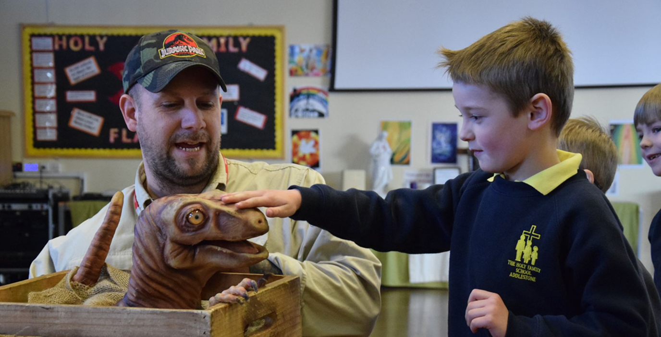
Why Academise?

Slide 5
Why Academise?
Government perspective
Diocesan perspective
Local Authority perspective
Our perspective

Slide 6
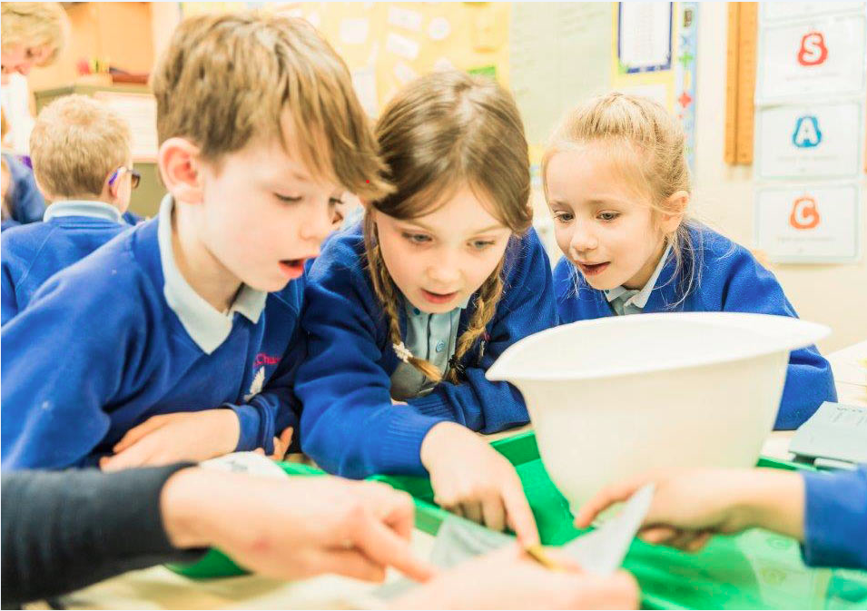
What are others doing?

Slide 7
Surrey Catholic Schools
Key
Xavier School
Academy Order granted
Initial conversations
Nothing yet agreed
Weybridge
Salesian, Chertsey
Cardinal Newman (2FE), Hersham
St. Alban’s (2FE), Molesey
St. Anne’s (2FE), Chertsey
Holy Family (1FE), Addlestone
St. Charles Borromeo (1FE), Weybridge
St. Cuthbert’s (1FE), Englefield Green
St. Paul’s (2FE), Thames Ditton
Guildford
St. Peter’s, Guildford
St. Joseph’s (3FE), Guildford
St. Polycarp’s (2FE), Farnham
St. Thomas of Canterbury (2FE), Guildford
St. Cuthbert Mayne (1FE), Cranleigh
St. Edmund’s (1FE), Godalming
Epsom & Redhill
St. Joseph’s (3FE), Redhill
St. Francis’ (2FE), Caterham
St. Andrew’s, Leatherhead
St. Clement’s (1FE), Ewell
St. Peter’s (2FE), Leatherhead
St. Bede’s, Redhill
St. Joseph’s (1FE), Dorking
St. Anne’s (2FE), Banstead
St. Joseph’s (2FE), Epsom
Woking
SJB, Woking
The Marist (2FE), West Byfleet
St. Augustine’s (2FE), Frimley
St. Hugh of Lincoln (1FE), Knaphill
St. Dunstan’s (3FE), Woking

Slide 8
How do we serve our schools?
Catholic Ethos
Professional Development
Curriculum
Learning & Teaching
School Improvement
Governance
Finance
Estates Management
IT
Systems
Human Resources
Inclusion
Safeguarding
Networks

Slide 9
What will change?
For children?
For parents?
Systems e.g. MIS, payroll, finance, reporting
Accountability
Governance
Expectations
Support

Slide 10
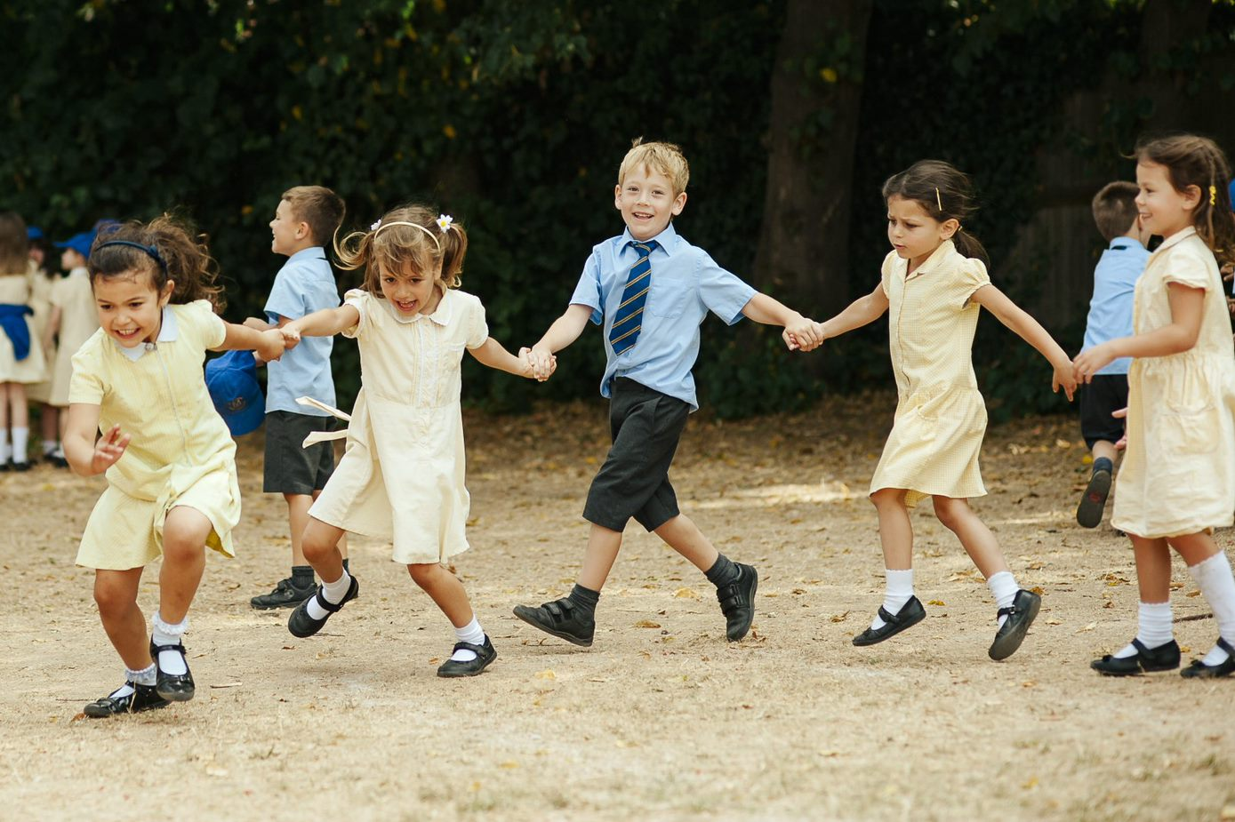
What happens next?

Slide 11

St. Clement’s Consultation
James Kibble

